Slide 1
Olist Business Insights
Prepared by Ammad Ali,
Muhammad Umar,
and Najaf Mumtaz

Slide 2
Agenda
Our Analysis Process
The Business Problem
Time Series Analysis
Customer Behaviour Analysis
Product Performance Insights
Geographical Analysis
Recommendations

Slide 3

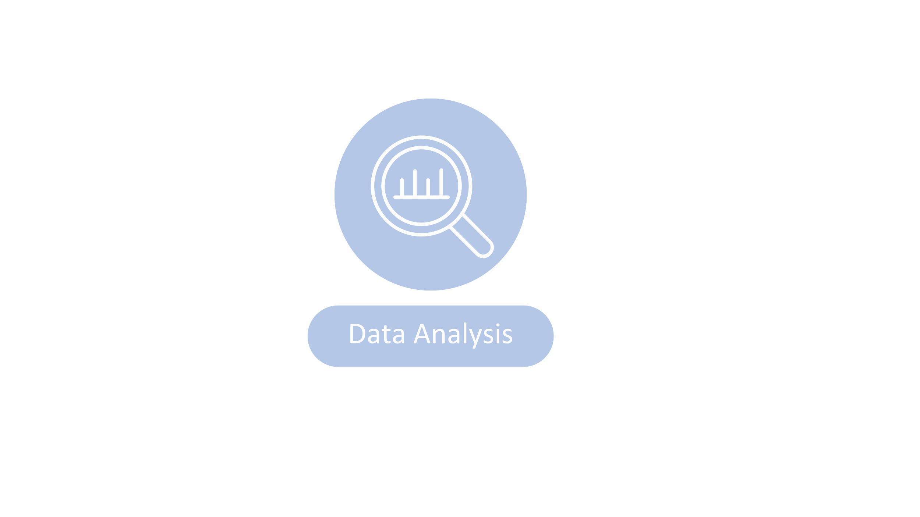


Our Analysis Process
Understanding the business problem
Identifying Data
Cleaning Opportunities
Analyzing the Data
for
Trends and Patterns
Making Recommendations
Based on the
Insights Gathered

Slide 4

The Business Problem

Slide 5
The Business Problem
Exploring the Olist dataset to gain a better understanding of customer behavior, order trends, and product performance.
Uncovering key insights related to popular product categories, peak order periods, and the distribution of customers and sellers across different geographic locations.

Slide 6
Olist – Business Model Explained

Slide 7




Small and Micro Businesses
Olist
Larger Online Marketplaces and Retailers
End Consumer

Slide 8
The Olist Dataset

Slide 9


Slide 10

Time Series Insights

Slide 11
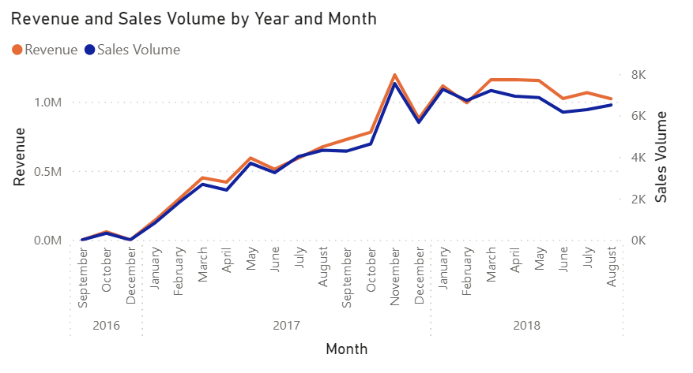
Sales By Year (And Month)

Slide 12
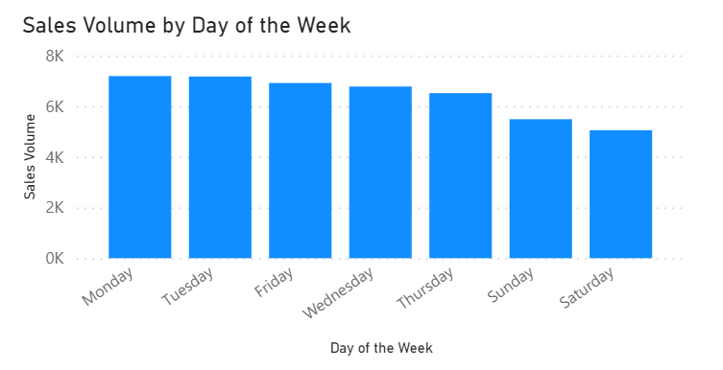
Sales Volume by Day of the Week (2017)

Slide 13
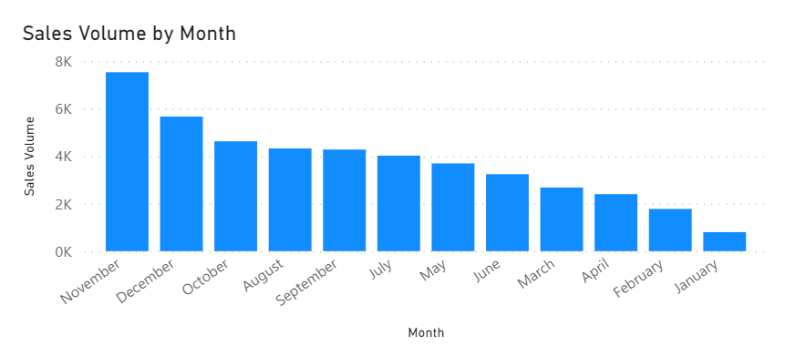
Sales Volume by Month (2017)
In terms of Sales Volume(2017), November was the most popular month, followed by behind by December and October.

Slide 14
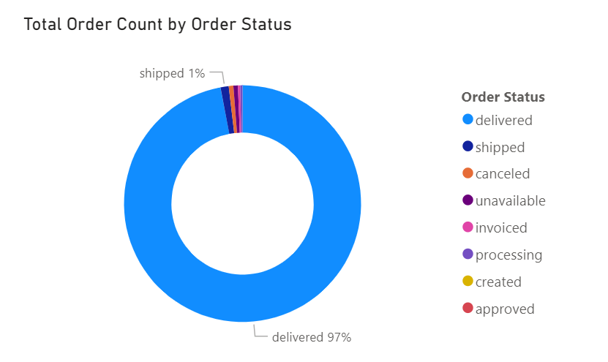
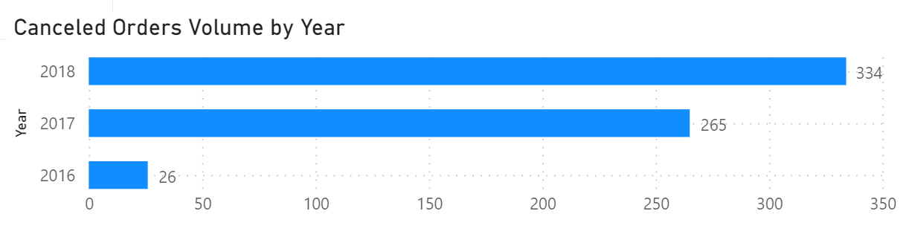
Olist has a robust delivery rate – of the total orders placed, less than 0.3% were cancelled and a whopping 97% were delivered.
Collectively, canceled, unavailable, invoiced, processing, created, and approved orders accounted for less than 2% of all orders.

Slide 15
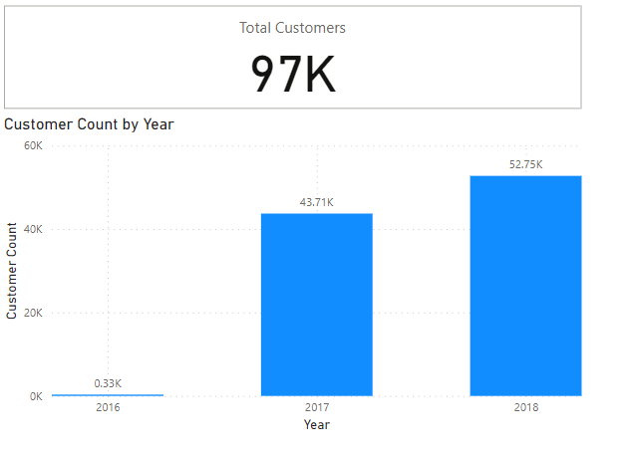
Customer Count By Year
13309%
21%

Slide 16

Customer Behavior Insights

Slide 17
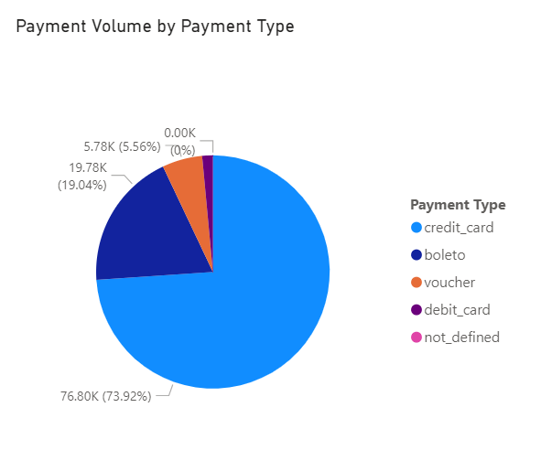
Preferred Payment Method
Credit Card Dominance:
Credit cards make up the majority of the payment transactions, accounting for a whopping 73.92% of all payments.
Boleto and Vouchers Remain Popular:
Collectively boleto and voucher payments made up a sizeable chunk, representing nearly 24.6% of all payments.
Minimal Debit Card Usage:
Payments made via debit card accounted for around 0.003% of all payments.

Slide 18
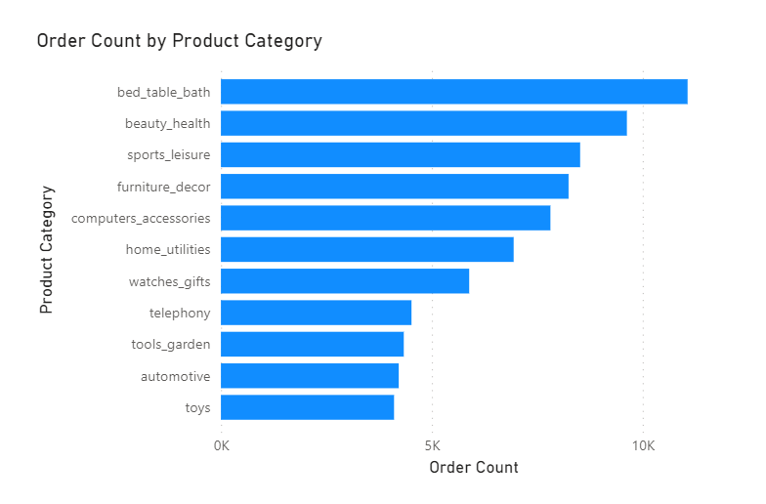
Top 10 Most Popular Product Categories

Slide 19
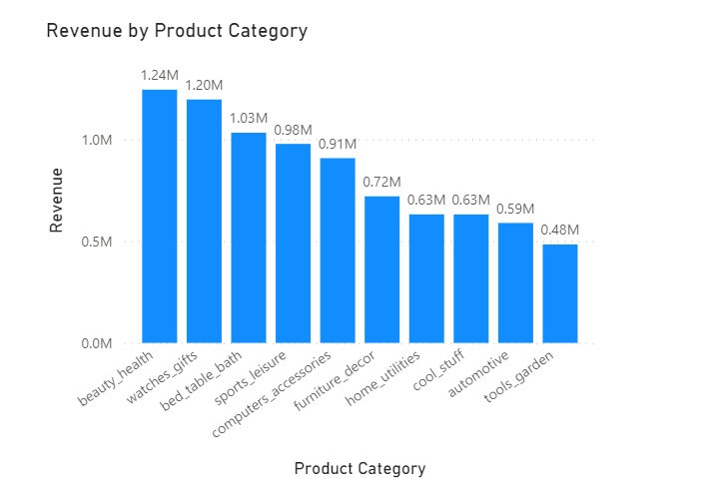
Top 10 Product Categories By Value

Slide 20

Geographical Insights

Slide 21
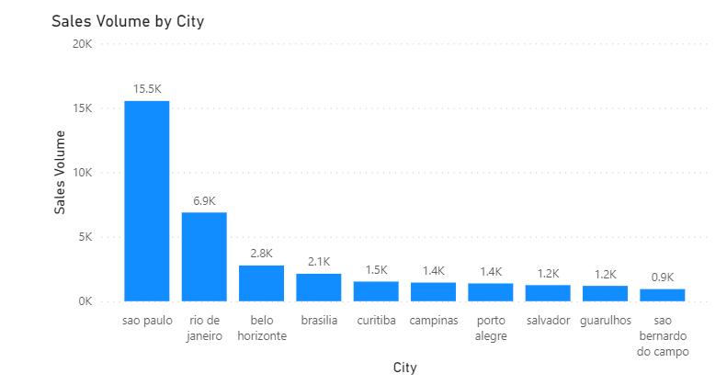
Top 10 Cities by Sales Volume

Slide 22
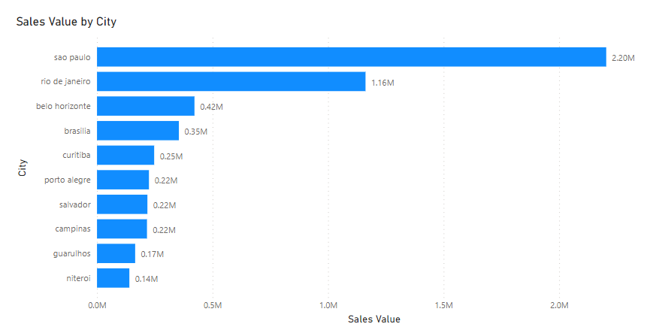
Top 10 Cities by Sales Value

Slide 23
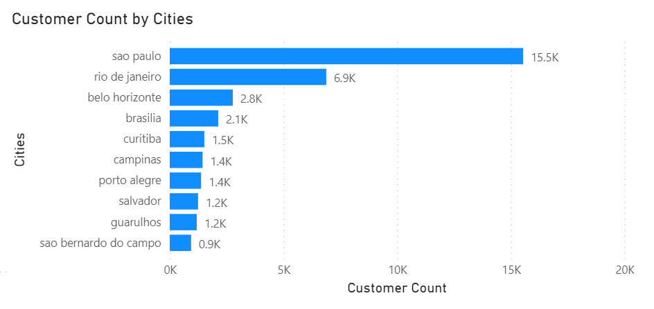
Top 10 Cities by Customer Concentration

Slide 24
Top 10 Cities by Customer Concentration

Slide 25
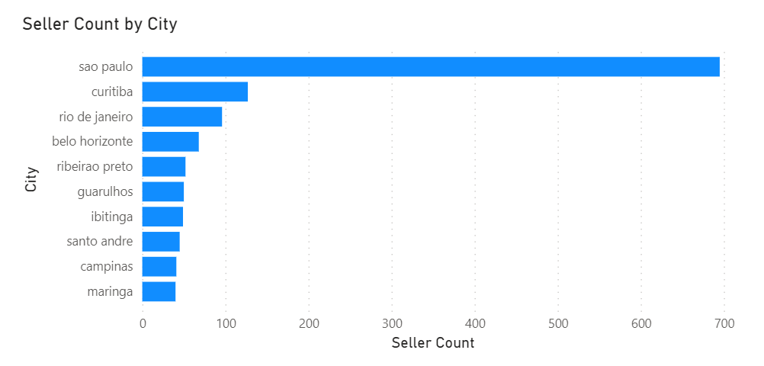
Top 10 Cities by Seller Concentration

Slide 26

Product Performance Insights

Slide 27
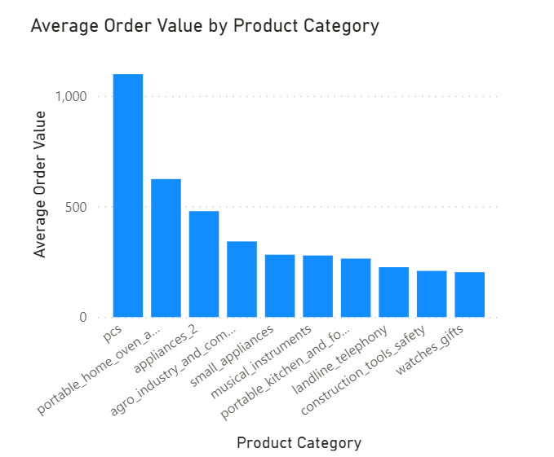
Top 10 Product Categories By Avg Order Value

Slide 28

Recommendations

Slide 29
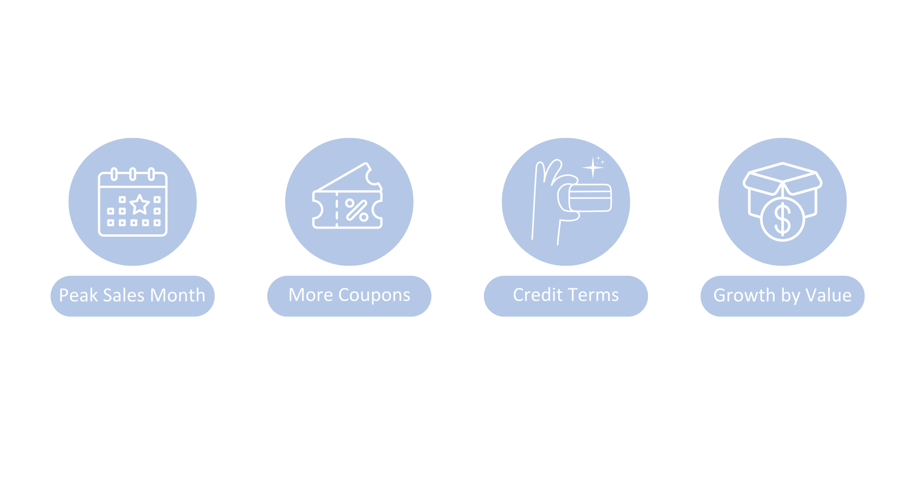
Recommendations
Capitalize
on Peak Sales Month
By Introducing Campaigns
Promote Boleto and
Voucher Utilization
to Increase Sales
Offer better credit
terms to encourage the
use of credit cards – the most
popular payment choice
Focus on increasing
Sales volume for product categories with higher average order values

Slide 30
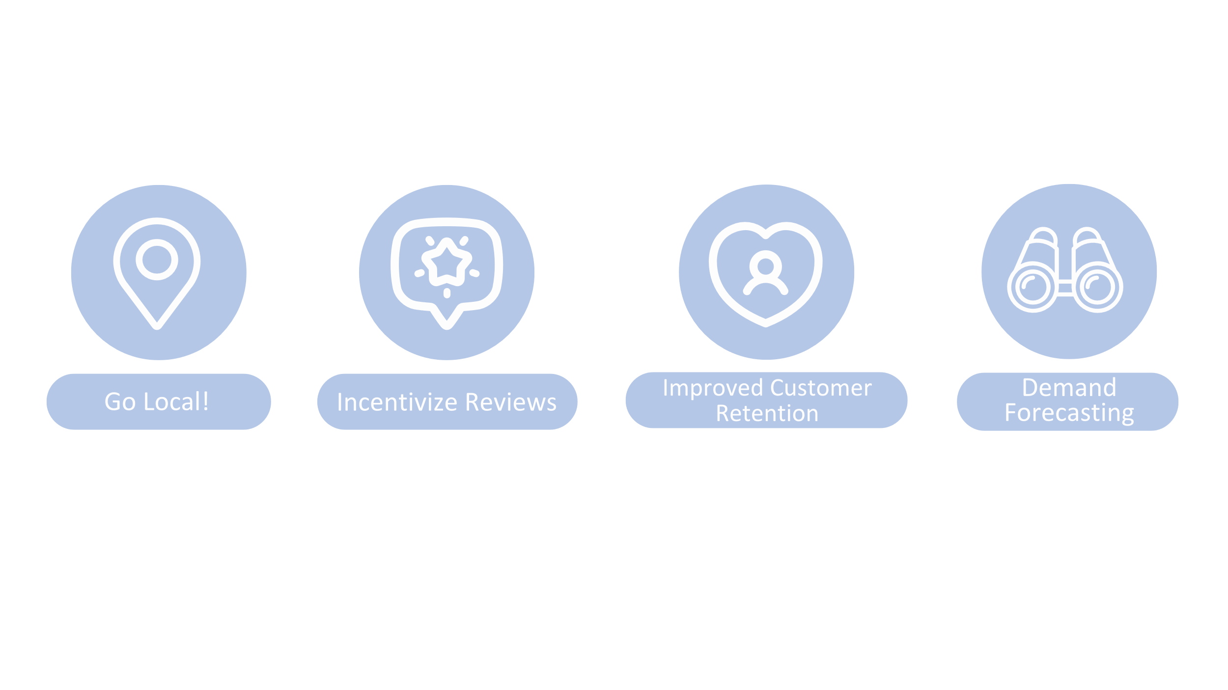
Recommendations
Focus on targeted marketing campaigns that cater specifically to the top cities
Incentivize customers to post reviews both on and outside the platform
Focus marketing efforts
on retaining customers and
building loyalty
Share valuable customer demand analytics
with sellers

